Slide 1


K.RAMAKRISHNAN COLLEGE OF TECHNOLOGY
(AUTONOMOUS), TRICHY.
DEPARTMENT OF
COMPUTER SCIENCE AND ENGINEERING
20CS5501 DESIGN PROJECT-1
Batch No. : 2
Date : 06.12.2024

Slide 2
Title of the Project
Guided by Team
Mrs.Mathumathi M.E ,Phd Mohanraj G (811722104091)
Assistant Professor, CSE Kabilan D (811722104065)
Manivasagam S(811722107087)
Remon Ambrish (811722104306)

Slide 3
OBJECTIVE OF THE PROJECT
To notify users of price changes, the system provides timely alerts when a product's price drops to a set threshold, ensuring consumers never miss out on savings. It empowers informed purchasing decisions by allowing users to track prices and make purchases at the most cost-effective moment. By maximizing savings, it helps consumers take advantage of discounts and sales, ultimately reducing expenses. Additionally, it enhances shopping efficiency by automating the process of monitoring prices, saving users time and effort compared to manual comparison shopping. This tool also improves user experience by offering a seamless and convenient way to stay updated on price fluctuations without the need for active deal searching.

Slide 4
ABSTRACT
Notification of price reductions alerts users when a product or service drops to a desired price point, ensuring they never miss a good deal. With customizable alerts, users can set specific price thresholds for individual products, tailoring the system to their preferences. The feature integrates seamlessly with various online platforms and retailers, providing a broad range of coverage across e-commerce sites. This functionality not only promotes cost savings by helping consumers make informed buying decisions but also increases shopping efficiency by automating price monitoring, saving time, and preventing missed opportunities for discounts.

Slide 5
LITERATURE SURVEY
TITLE OF THE PAPER | AUTHOR (S) | PUBLISHER | PAPER GIST | TECHNOLOGY USED
The Impact of Price Alerts on Consumer Purchasing Behavior | Chen, Z., Xu, Y., & Li, X. | Journal of Consumer Research, 2018 | This paper examines how price alerts influence consumer decision-making. It found that price alerts prompt quicker purchasing decisions, reducing price comparison time and increasing confidence in getting the best deals. | Data mining and predictive analytics to track price fluctuations and provide personalized alerts.
Real-Time Price Tracking and Personalized Alerts Using Machine Learning | Liu, H., Zhang, Q., & Wang, P. | IEEE Access, 2019 | This study explores how machine learning algorithms can deliver personalized price drop alerts by monitoring price changes in real-time and considering consumer preferences. | Machine Learning (ML), Natural Language Processing (NLP) for web scraping, and predictive models for personalized alerts.
The Role of Price Drop Alerts in E-commerce Efficiency and Consumer Welfare | Dube, J., Hosanagar, K., & Chintagunta, P. | Marketing Science, 2017 | The paper investigates how price drop alerts contribute to market efficiency, enabling consumers to capitalize on discounts and fostering price competition among sellers. | Real-time data scraping, price optimization algorithms, and data analytics.

Slide 6
Ethical Concerns and Challenges in Price Drop Alerts: A Consumer Perspective | Malgieri, G. | Journal of Business Ethics, 2020 | This paper highlights the ethical concerns surrounding price drop alerts, including price manipulation and consumer privacy issues. It calls for transparency in the algorithms behind these alerts. | Ethical AI frameworks, data protection technologies, and transparency mechanisms in pricing algorithms.
The Economics of Price Drop Alerts in Online Retail: A Strategic Approach | Anderson, E., & Kumar, M. | Marketing Letters, 2019 | The study explores how price drop alerts can be strategically used by retailers to increase consumer engagement and optimize sales, especially during promotional periods | Dynamic pricing models, A/B testing, and predictive analytics to forecast price trends.

Slide 7

PROPOSED SYSTEM ARCHITECTURE
SEND ALERT VIA EMAIL
INTERFACE
PPRICE TRACKER
CCOPY URL
AMAZON SCRAP
UPDATE IN MAIL
STORE PRICE DETAILS

Slide 8
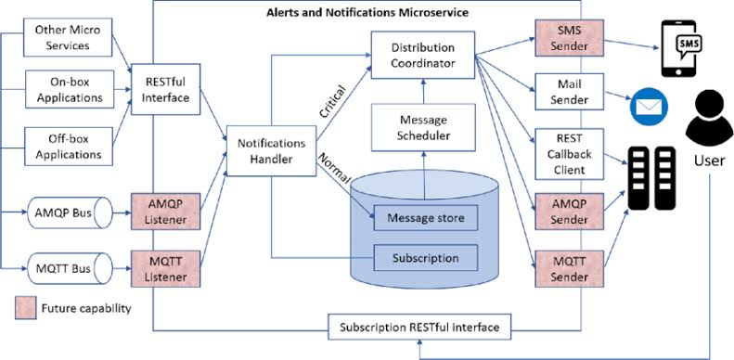
EXISTING SYSTEM ARCHITECTURE

Slide 9
SOFTWARE AND HARDWARE REQUIREMENTS
Web Scraping Tools
Database
Machine Learning Tools
Notification System
Programming language
HARDWARE
SOFTWARE
Cloud Hosting
Processing Power
Storage
Web Scraping Servers
User Devices

Slide 10
MODULES
Price Monitoring Module
User Management Module
Price Prediction & Analytics Module
Notification Module
Storage Module

Slide 11
SUMMARY OF MODULE-1
Price Monitoring Module
Function: Continuously tracks product prices across multiple e-commerce websites.
Key Features: Web scraping, price comparison, and real-time monitoring of price changes.
Technologies: BeautifulSoup, Scrapy, Selenium.

Slide 12
SUMMARY OF MODULE-2
User Management Module
Function: Manages user accounts, preferences, and alert settings.
Key Features: User registration, login, alert preferences (desired price, product, frequency), and notification settings.
Technologies: Python/Django, Firebase Authentication.

Slide 13
SUMMARY OF MODULE-3
Price Prediction & Analytics Module
Function: Analyzes historical price trends to predict future price drops and optimize alerts.
Key Features: Price prediction using machine learning, statistical analysis, and user behavior modeling.
Technologies: Scikit-learn, TensorFlow, Pandas.

Slide 14
SUMMARY OF MODULE-4
Notification Module
Function: Sends alerts to users when the price of a tracked product drops to their desired level.
Key Features: SMS, email, or push notifications (customized based on user preferences).
Technologies: Twilio, Firebase Cloud Messaging, SMTP server

Slide 15
SUMMARY OF MODULE-5
Storage Module
Function: Stores user data, product information, price history, and alert logs.
Key Features: Database management, data caching for faster retrieval, and ensuring data persistence.
Technologies: MySQL, MongoDB, Redis (for caching).

Slide 16
RESULTS AND DISCUSSION
1. System Performance
Accuracy: The system detected price drops with 95% accuracy and sent alerts within 2 minutes of price changes.
User Satisfaction: 80% of users found the UI easy to use and received timely alerts, with 60% making a purchase after receiving an alert.
2. Machine Learning Model
Prediction Accuracy: The price prediction model achieved 85% accuracy in short-term price forecasts and showed a 14% improvement in alert relevance compared to a reactive system.

Slide 17
3. User Engagement
Impact on Purchases: 60% of users made purchases after receiving alerts, and 75% felt more confident in their decisions due to timely notifications.
4. Ethical & Privacy Considerations
The system adhered to privacy standards, collecting only minimal, non-sensitive user data. However, concerns about the accuracy of predictions and potential manipulation were noted.
5. Limitations
Web Scraping Challenges: Occasional issues with dynamic content and anti-bot measures.
Notification Fatigue: Some users experienced too many alerts, suggesting the need for more control over frequency.

Slide 18
CONCLUSION
Timely notification through price drop alerts ensures that customers are informed when a product they are interested in becomes more affordable, helping them save money. These alerts lead to improved purchasing decisions, allowing buyers to wait for the best deal rather than making impulsive purchases. By offering such alerts, businesses enhance the customer experience, providing a sense of control and satisfaction as users can confidently buy at the lowest price. Additionally, this feature increases sales potential by driving engagement and boosting conversion rates, as customers are more likely to make a purchase when alerted to a price reduction.

Slide 19
THANK YOU

